Slide 1
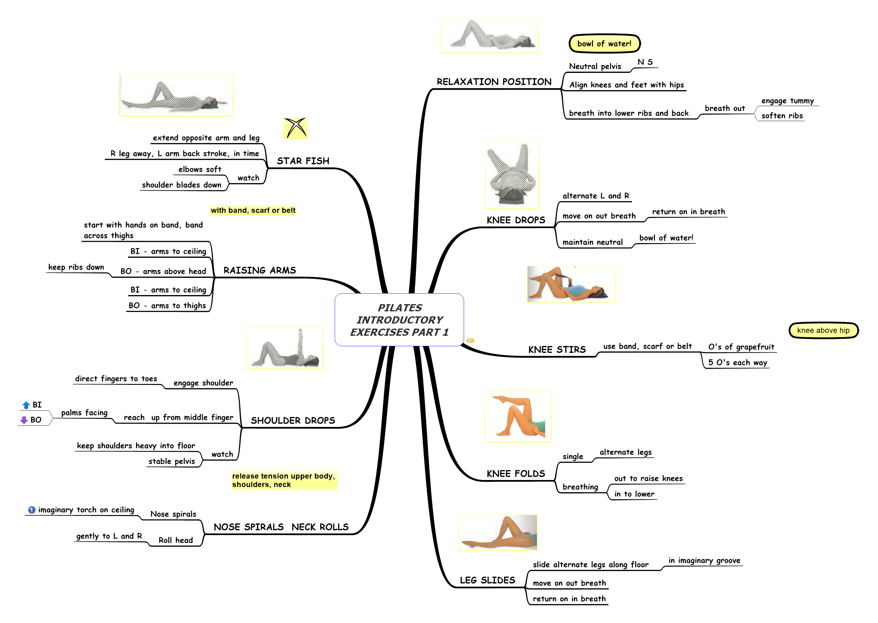
Gillian Burn - 2024 – www.healthcircles.co.uk/pilates-exercise 07831 526531

Slide 2
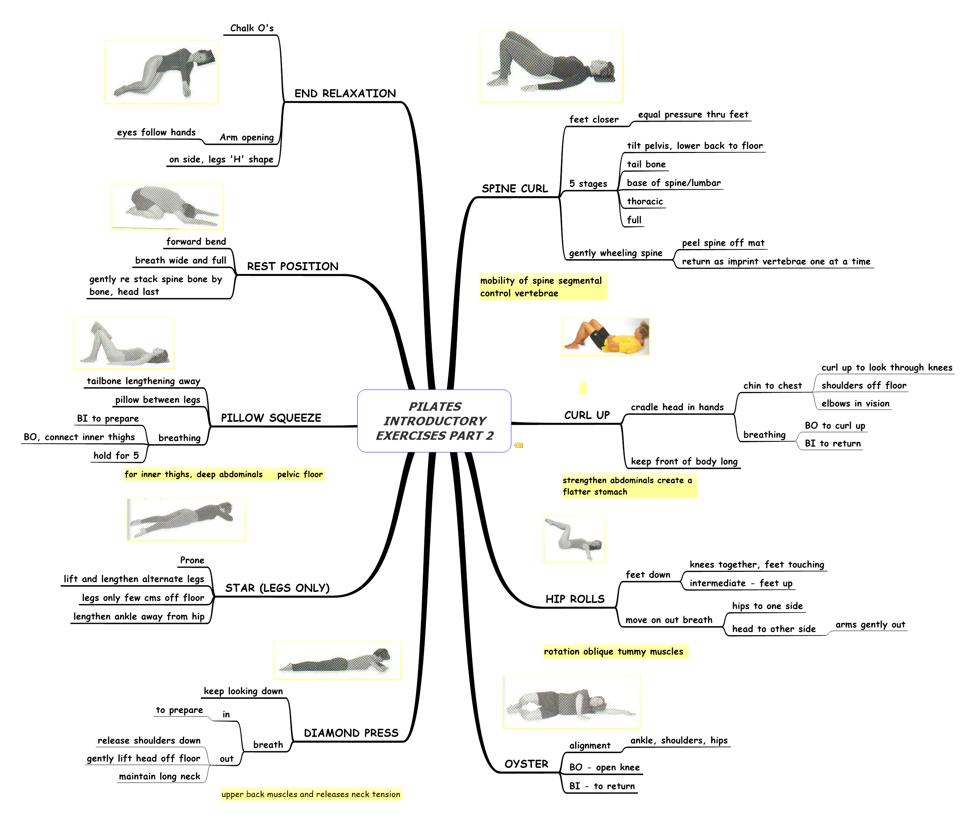
Gillian Burn - 2022 – www.healthcircles.co.uk/pilates-exercise 07831 526531

Slide 3
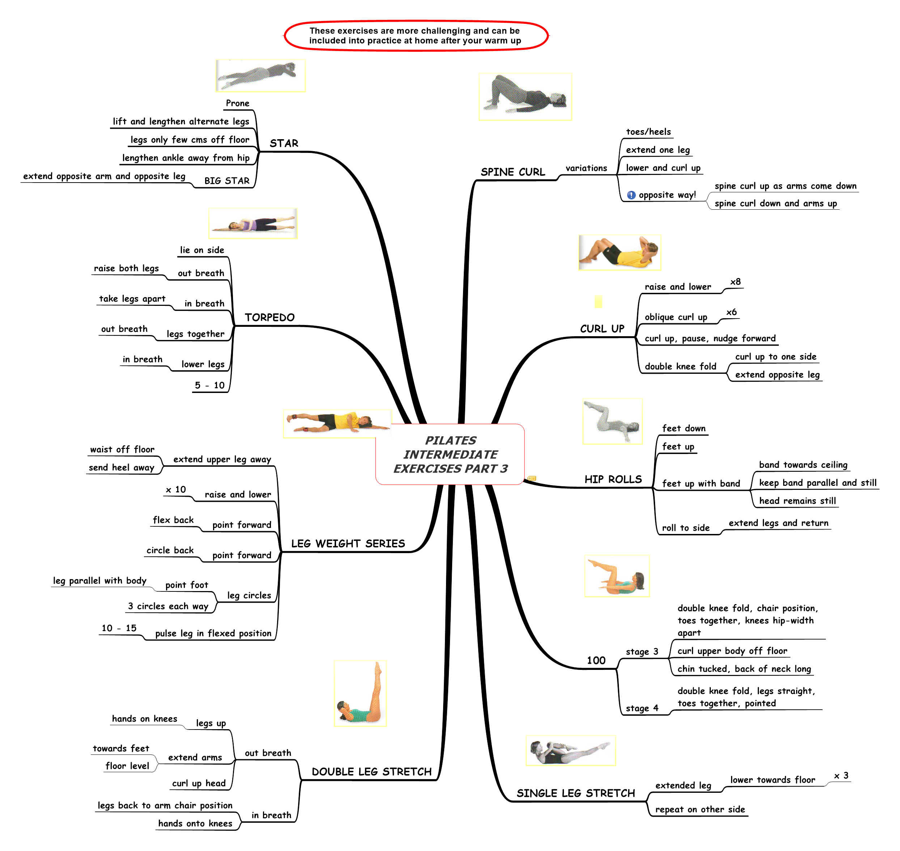
Gillian Burn - 2024 – www.healthcircles.co.uk/pilates-exercise 07831 526531

